Slide 1

MACHINE LEARNING TECHNIQUES
TOPIC:IN-PROCESS DETECTION OF GRINDING BURN USING MACHINE LEARNING
Presented by:
DEEPAK KUMAR S
Mechanical (2021111320)

Slide 2

Abstract
Grinding burns result from thermal damages due to excess heat in the grinding processes, which can severely affect surface integrity and fatigue life of the machined parts.
Accurately predicting grinding burns is crucial for ensuring product quality and reducing manufacturing defects. This study proposes a machine learning approach, utilizing a Support Vector Machine (SVM) with a linear kernel, to predict the occurrence of grinding burns based on operational parameters such as wheel speed, feed rate, and depth of cut. A synthetic dataset is generated to model the relationship between these parameters and the occurrence of burns.
The SVM model is trained and validated on this dataset, with data pre-processing steps including feature scaling to enhance model performance. The effectiveness of the model is quantified through metrics such as accuracy and a confusion matrix. The results demonstrate the potential of SVM in predictive maintenance and quality control in manufacturing processes.

Slide 3

Introduction
BACKGROUND: Grinding is a widespread manufacturing process where material is removed using an abrasive wheel. This process can generate high heat which, if not controlled, leads to grinding burns. These burns can compromise the mechanical properties and longevity of the product. Detecting and predicting grinding burns is thus a significant challenge in the manufacturing industry.
PROBLEM STATEMENT: Traditional methods for detecting grinding burns involve post-process inspection techniques that are not only time-consuming but also costly. There is a need for a proactive approach that can predict the likelihood of burns occurring during the grinding process, enabling adjustments in real-time to mitigate potential damage.

Slide 4

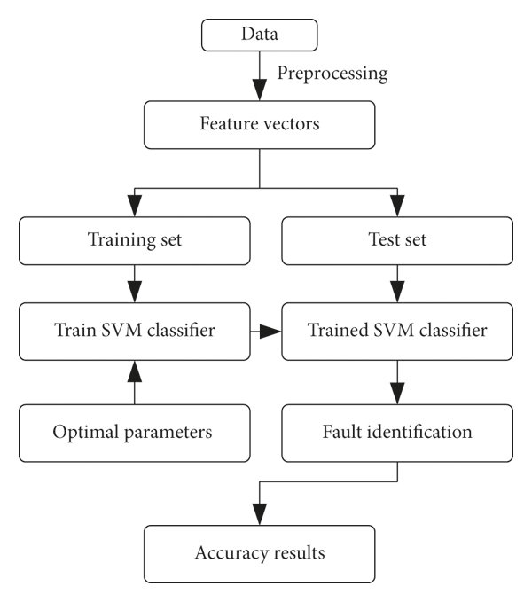
STRUCTURE

Slide 5

Methodology

Slide 6

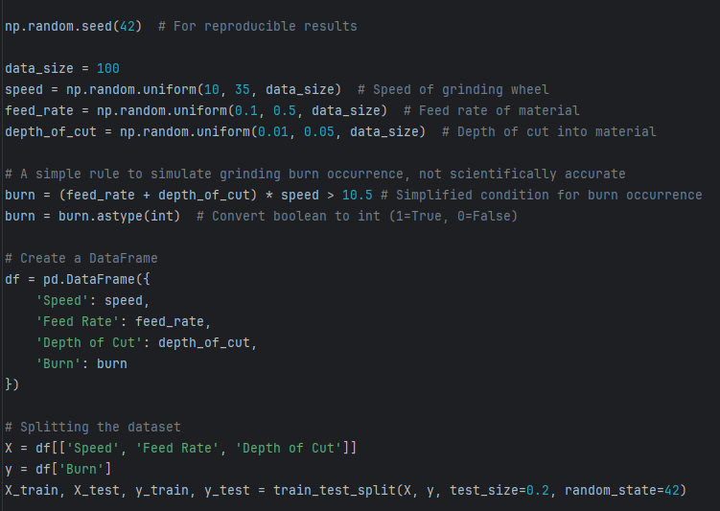
Data Simulation:
Given the absence of real-world data, the project involves the generation of a synthetic dataset simulating various grinding scenarios. Parameters like speed of the grinding wheel, feed rate, and depth of cut are manipulated to create a dataset representing different operational conditions.

Slide 7

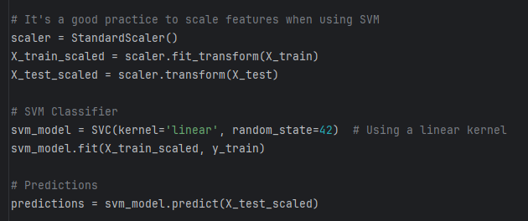
Model Development:
A Support Vector Machine (SVM) classifier with a linear kernel is employed to model the relationship between the grinding parameters and the occurrence of burns. The choice of SVM is motivated by its effectiveness in binary classification tasks, especially with a clear margin of separation.

Slide 8
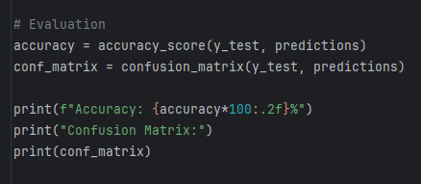
Evaluation:
The model is trained and tested using an 80-20 train-test split of the data. Feature scaling is performed to normalize the data and enhance the learning performance. Model success is evaluated based on its accuracy and the confusion matrix to understand its precision and recall capabilities.

Slide 9
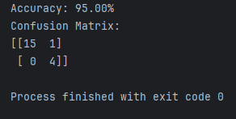
Output:

